Slide 1
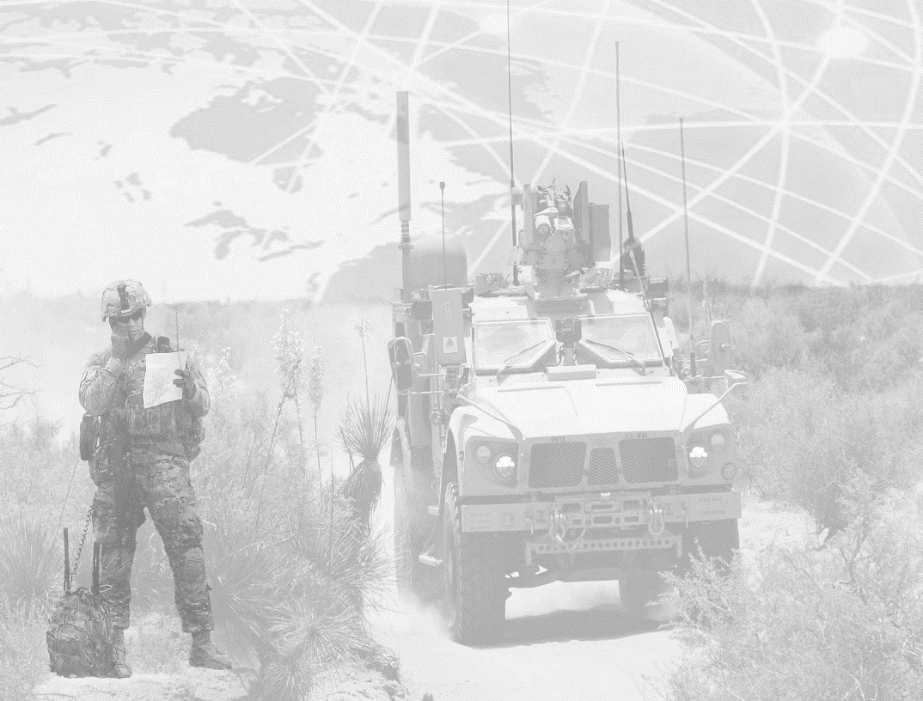
Brigade Modernization Command Winter AUSA Global Force
Symposium & Exposition “Building Readiness for Today and Tomorrow”
BG Terrence McKenrick
Commanding General
16 March 2016
Unclassified

Slide 2
Purpose and Agenda
Purpose: to educate the military and industry members on the Brigade Modernization Command, Army Warfighting Assessments (AWA)
Agenda
Network Integration Evaluations (NIE) vs. Army Warfighting Assessments (AWA)
Army Warfighting Challenges
Concepts and Capabilities
Value of AWA
AWA 17 Way Ahead

Slide 3
Brigade Modernization Command Tangible Results for the Future Forces
Mission: The Brigade Modernization Command conducts integration and evaluations of the network, non-network, and other developmental and emerging concepts and capabilities in order to provide Doctrine, Organization, Training, Materiel, Leadership and Education, Personnel, Facilities and Policy (DOTMLPF-P) recommendations to the Army.
Network Integration Evaluations (NIE)
INTEGRATION
Conducted annually in the spring
Executed 10 x NIEs (NIE 11.2 – NIE 16.1)
Integrates Army tests on Programs of Record (POR) within a brigade force-on-force exercise
Operationally relevant and demanding scenarios, with a robust simulation wrap-around
Primarily focused on the network, mission command systems, and other networked systems
Army Warfighting Assessments (AWA)
INNOVATION
Conducted annually in the fall
Triple payoff: Training Readiness, Future Force Development and Joint/Multinational Interoperability
Provides opportunity to assess concepts and capabilities without formal test constraints
Partnership with Industry to improve engineering and system development
Focus Areas from NIE/AWA
NIE 15.2
24 APR– 20 MAY 2015
Distributed Common Ground System-Army (DCGS-A) test (intel analysis system)
Simplified tactical intel architecture
Transport convergence (reducing network hardware)
Air/Ground Integration
NIE 16.1/AWA
25 SEP – 08 OCT 2015
Assessed 78 x concepts and capabilities
Included a UK Brigade HQs, Canadian Infantry, and Norwegian Artillery
Joint Forcible Entry Operations with 82nd Airborne Division and 101st Airborne Division
NIE 16.2
23 APR– 16 MAY 2016
Spider (command activated munition)
Warfighter Information Network-Tactical (WINT)
Command Post Computing Environment (CP CE)
Transport convergence (reducing network hardware)
Air/Ground Integration
AWA 17
17 Oct– 30 Oct 2016
Joint Maneuver Entry Ops
Air-Ground Recon Security
Counter Weapons Mass Destruction
Theater/Sustain Operations
Mobile Protected Fire (MPF)/Ground Mobility Vehicle (GMV)/Light Reconnaissance Vehicle (LRV) for the dismounted Infantry

Slide 4
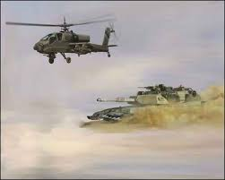
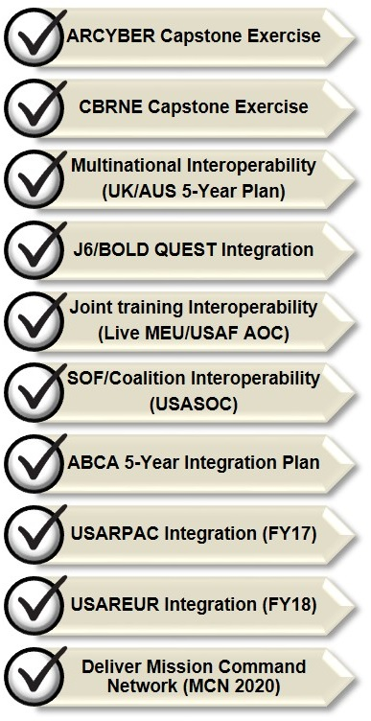


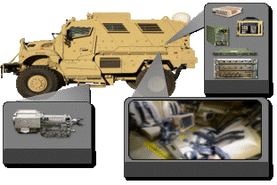



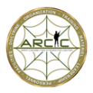














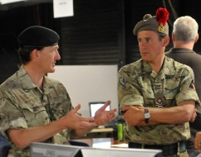


Army Warfighting Assessments
Assessing interim solutions to Army Warfighting Challenges
1. Develop Situational Understanding
2. Shape the Security Environment
3. Provide Security Force Assistance
4. Adapt the Institutional Army
5. Counter Weapons of Mass Destruction
6. Conduct Homeland Operations
7. Conduct Space and Cyber Electromagnetic Operations and Maintain Communications
8. Enhance Training
9. Improve Soldier, Leader and Team Performance
10. Develop Agile and Adaptive Leaders
11. Conduct Air-Ground Reconnaissance
12. Conduct Joint Expeditionary Maneuver and Entry Operations
13. Conduct Wide Area Security
14. Ensure Interoperability and Operate in a Joint, Interorganizational, and Multinational Environment
15. Conduct Joint Combined Arms Maneuver
16. Set the Theater, Sustain Operations, and Maintain Freedom of Movement
17. Integrate Fires
18. Deliver Fires
19. Exercise Mission Command
20. Develop Capable Formations
Informs Operational and Organizational (O&O) concept development
DOTMLPF Analysis / Joint Report
Training
Readiness
Future Force
Development
Interoperability
The Army Warfighting Assessments (AWA) is the CSA’s capstone event for Force 2025 Maneuvers that provides the Army a venue to achieve “Triple Payoff” objectives, which include: Training Readiness, Future Force Development, and Joint/Multinational Interoperability in a resource constrained environment.

Slide 5
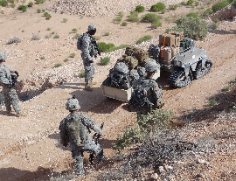

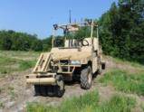













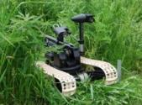
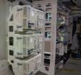

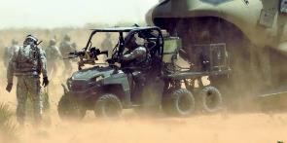
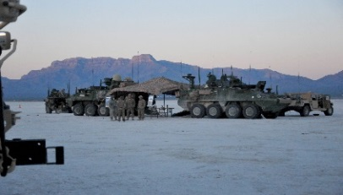
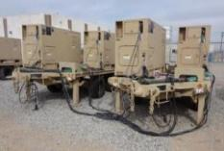
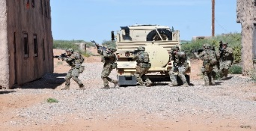
What We Evaluate and Integrate – Concepts and Capabilities
Military: 142
Government (GS) 49
_________________
191
Future Force Development
Joint and Multinational Interoperability
Squad Transport Robot
Armed Defensive Robots
Manned-Unmanned Teaming
Small Form Unmanned Aerial Surveillance Aircraft
Warfighter Information Network
Multiple Radio Waveforms and Platforms
In-Flight Full Motion Video
Mobile Protected Firepower
Ground Mobility Vehicle
Light Reconnaissance Vehicle
Tactical Network
Robotics
Air-Ground Integration
Combat Vehicles
Expeditionary Command Posts
Training Readiness
Operational Energy
Stryker Tactical Command Post
Light-Mobile Command Post
Mission Command Vehicle
Expeditionary Base Camp
Solar Powered Generators
Portable “micro” Energy Grid
Fuel Efficient Generators
Reduced Size and Weight

Slide 6

Value of AWA and
Expected Outcomes
Focus: Modernization & Force Development
Value of AWA:
Meets objectives across training, future force development and interoperability
Provides large scale live, virtual, constructive Joint/multinational training for Army divisions
Enhances Joint and Multinational Integration
Ensure interoperability of systems, doctrine, and forces
Develops partnership with Industry
Enhances concepts and capability development process…potentially reduces acquisition timelines and improves test outcomes
Provides opportunity to improve/fix the network without formal test constraints
AWA
Assess new capabilities, organizations & doctrine
Assess human dimension
Refine & improve the network
Assess training innovations
Identify DOTMLPF solutions to Warfighter Challenges
Refine requirements
Readiness Opportunities
Expedited DOTMLPF Solutions
Improved Engineering
OUTCOMES
MND TNG Exercise
Exercise distributed Mission Command in Joint/Multinational environment
Assess doctrinal interoperability
Employ Joint / MN forces in realistic operational environment
Live, Virtual, Constructive Mix
Live Cyber / EW Threat
Improved Network
Refined Doctrine
Improved Interoperability
Focus: Readiness
AWAs are opportunities to maximize collective resources to assess Training Readiness, Future Force Development, and Joint/Multinational Interoperability priorities.

Slide 7
AWA 17 Way Ahead
17 – 30 OCTOBER 2016
(Fort Bliss, White Sands Missile Range, Holloman AFB)
Army Warfighting Challenges
Army Warfighting Challenges
I Corps
1st Armored Division
Light Infantry Task Force
2nd Brigade, 1st Armored Division
Airborne Joint Forcible Entry Operations (JFEO) unit (Airborne/Air Assault/Special Operation Force)
Sustainment Brigade Headquarters and Support Battalion(s)
Theater Integrated Air Missile Defense
Multi-national (UK, Canada, Australia, Italy, Denmark)
USMC Fly-In Command Element & Marine Task Force Response Cells
Increased Navy participation
Forces Command (FORSCOM) Enablers
USAF Combined Air Ops Center
FORCES
Unified Land Operations
Joint Concept for Entry Ops (Joint Operation Access Concept (JOAC) and Expeditionary Force 21)
Set Theater
Joint/Multinational Operations
Special Operation Force – Coalition Forces Interoperability
Close Air Support/Joint Fires
Integrated Air/Missile Defense
Expeditionary Mission Command
Enhanced Maneuver
Cyber/Electronic Warfare
Sea Basing/Joint Logistic Over the Shore (JLOTS)
Squad Overmatch (cognitive skills)
Manned-Unmanned Teaming (robotics)
Light Cavalry
CONCEPTS
Regional Focus: U.S. Pacific Command
Manned – Unmanned Teaming
Operational Energy
Expeditionary Command Posts (v2)
Enhanced Maneuver
4G LTE Communications Network
Coalition Network
Counter-Unmanned Aircraft System (UAS)
CAPABILITIES

Slide 8
QUESTIONS?

